Slide 1
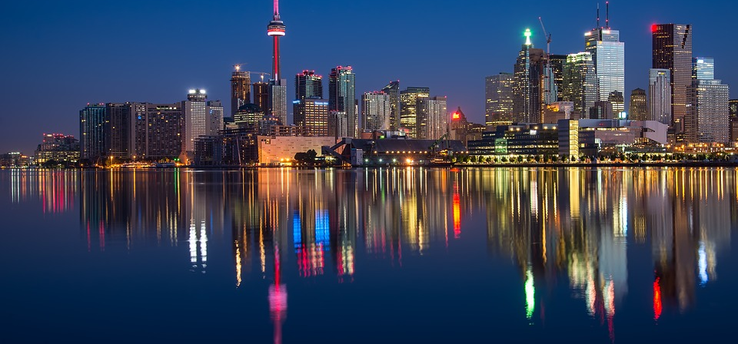
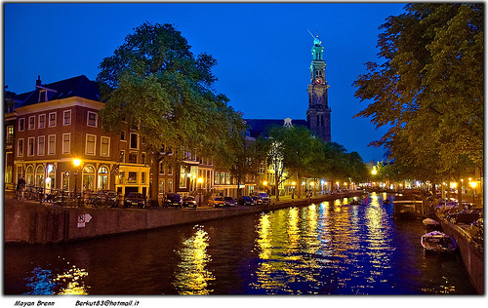
The Harmony of Neighborhoods
A comparison of venue clusters of boroughs in Amsterdam to venue clusters of boroughs in Toronto

Slide 2
Why compare venue clusters of boroughs in Amsterdam and Toronto?
Businesses in tourist industry may aim to attract clients
Organizations exploring venues world-wide may be looking for business opportunities
Policy makers may be looking to enhance the attractiveness of their cities

Slide 3
Description of data and its usage
Postal code data obtained from:
https://nl.wikipedia.org/wiki/Lijst_van_postcodes_1000-1999_in_Nederland#1000-1099
https://en.wikipedia.org/wiki/List_of_postal_codes_of_Canada:_M
Latitudes and longitudes of postal codes obtained from:
https://geocoder.readthedocs.io/providers/ArcGIS.html
https://cocl.us/Geospatial_data
Venue data obtained from:
https://api.foursquare.com

Slide 4
Methodology – Data acquisition and exploration
Scraping of postal codes from websites using python module BeautifulSoup
Retrieving latitudes and longitudes from arcgis and https://Geospatial_data
Store these data points in pandas dataframes
Visualize dataframes
Acquire venues within 500 meters of latitudes and longitudes from Foursquare
Standardize dataframes by equating categories of venues for Amsterdam and Toronto

Slide 5
Methodology – Inferential statistical testing
Create dataframes grouped by borough and containing the mean of the frequency of occurrence of each category of venue for postal codes belonging to each borough.
Print out the top 5 and the top 10 most common venues for each borough in Amsterdam and Toronto.

Slide 6
Methodology – Machine learning
Run the method of k-means clustering to find 5 clusters of boroughs that are similar in terms of venues existing in such boroughs
Add resulting cluster labels to the dataframes
Visualize the clusters on maps for Amsterdam and Toronto
Store the feature vectors of the clusters in variables 'amsterdam_cluster_centers' and 'toronto_cluster_centers’.
Calculate Euclidean distances pairwise between cluster centers in Amsterdam and Toronto to analyze similarities and dissimilarities
Print Euclidean distances in ascending order. Now, the clusters that are similar for Amsterdam and Toronto can be determined as well as those that are dissimilar.

Slide 7
Results - Data acquisition and exploration
63 rows of postal coders, boroughs, neighborhoods and their latitudes and longitudes for Amsterdam. 103 rows for Toronto
2129 rows of venue data for Amsterdam. 2237 rows for Toronto
After standardization:
191 unique categories of venues
1878 rows of venue data for Amsterdam
2033 rows of venue data for Toronto

Slide 8
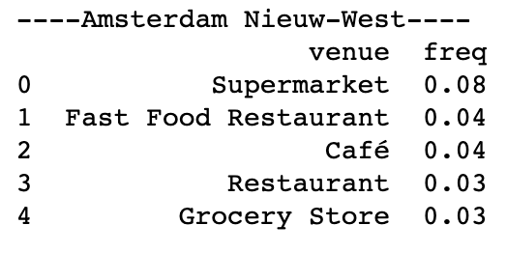
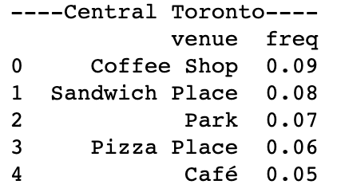
Results – Inferential statistical testing

Slide 9
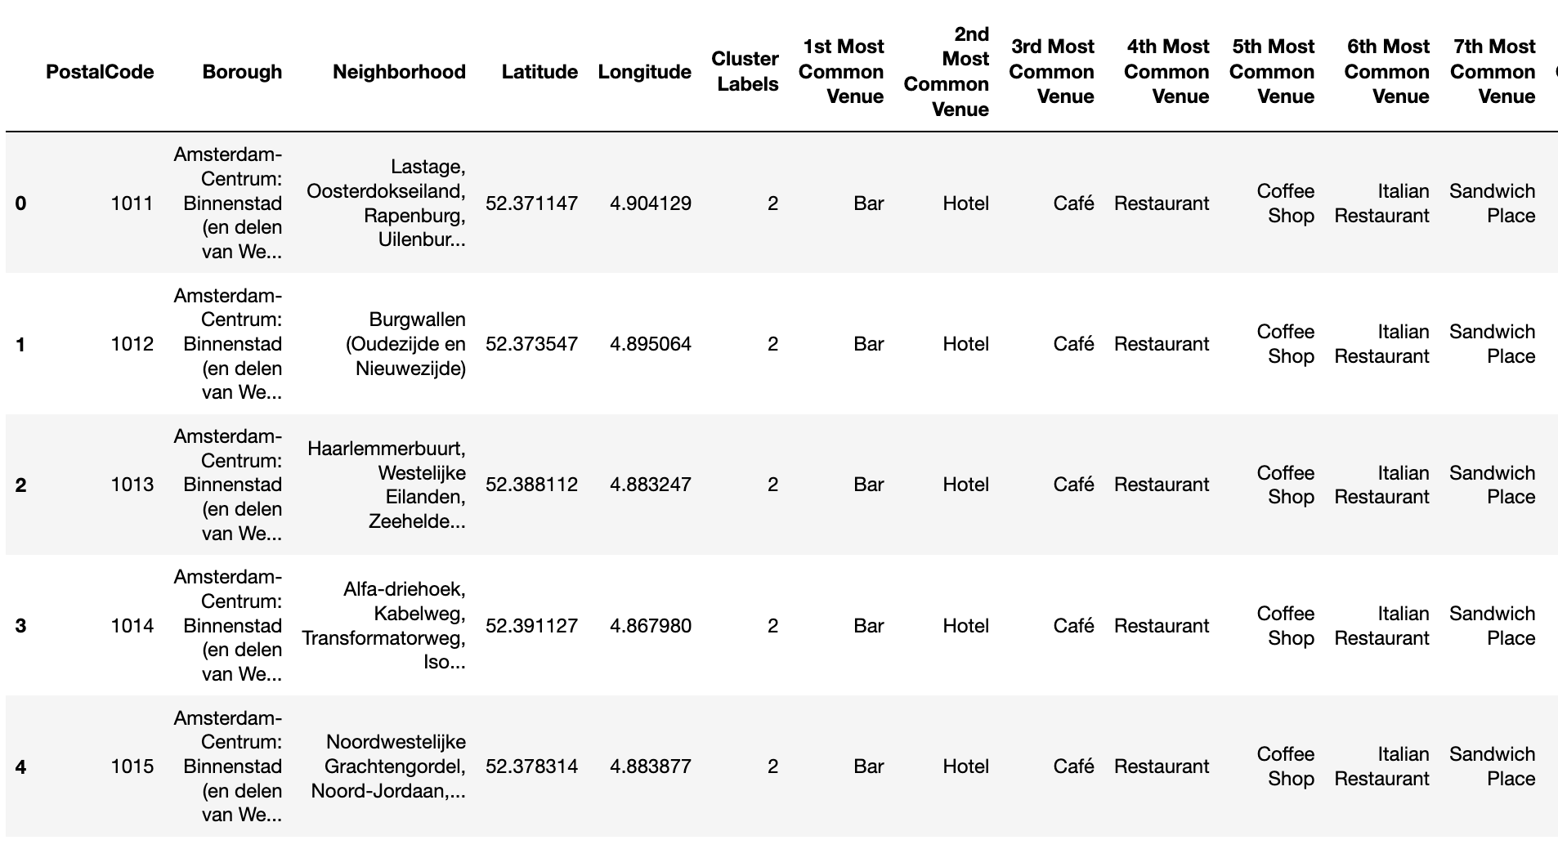
Results – Machine learning

Slide 10
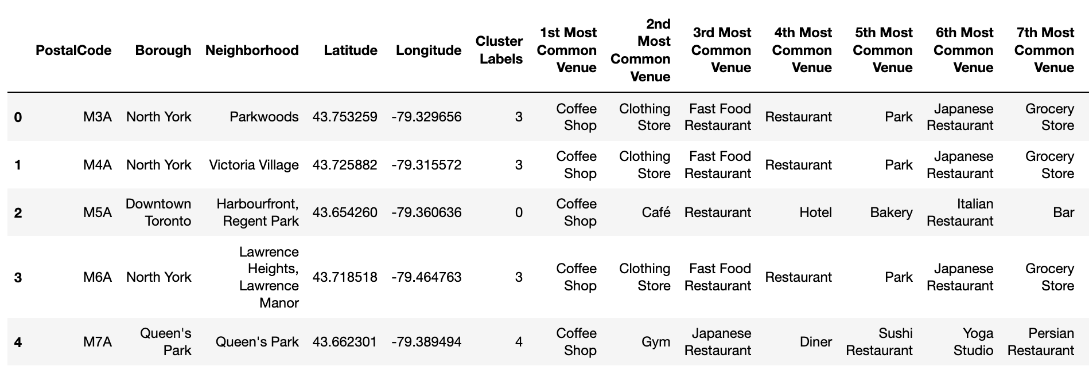
Results – Machine learning (cont.)

Slide 11
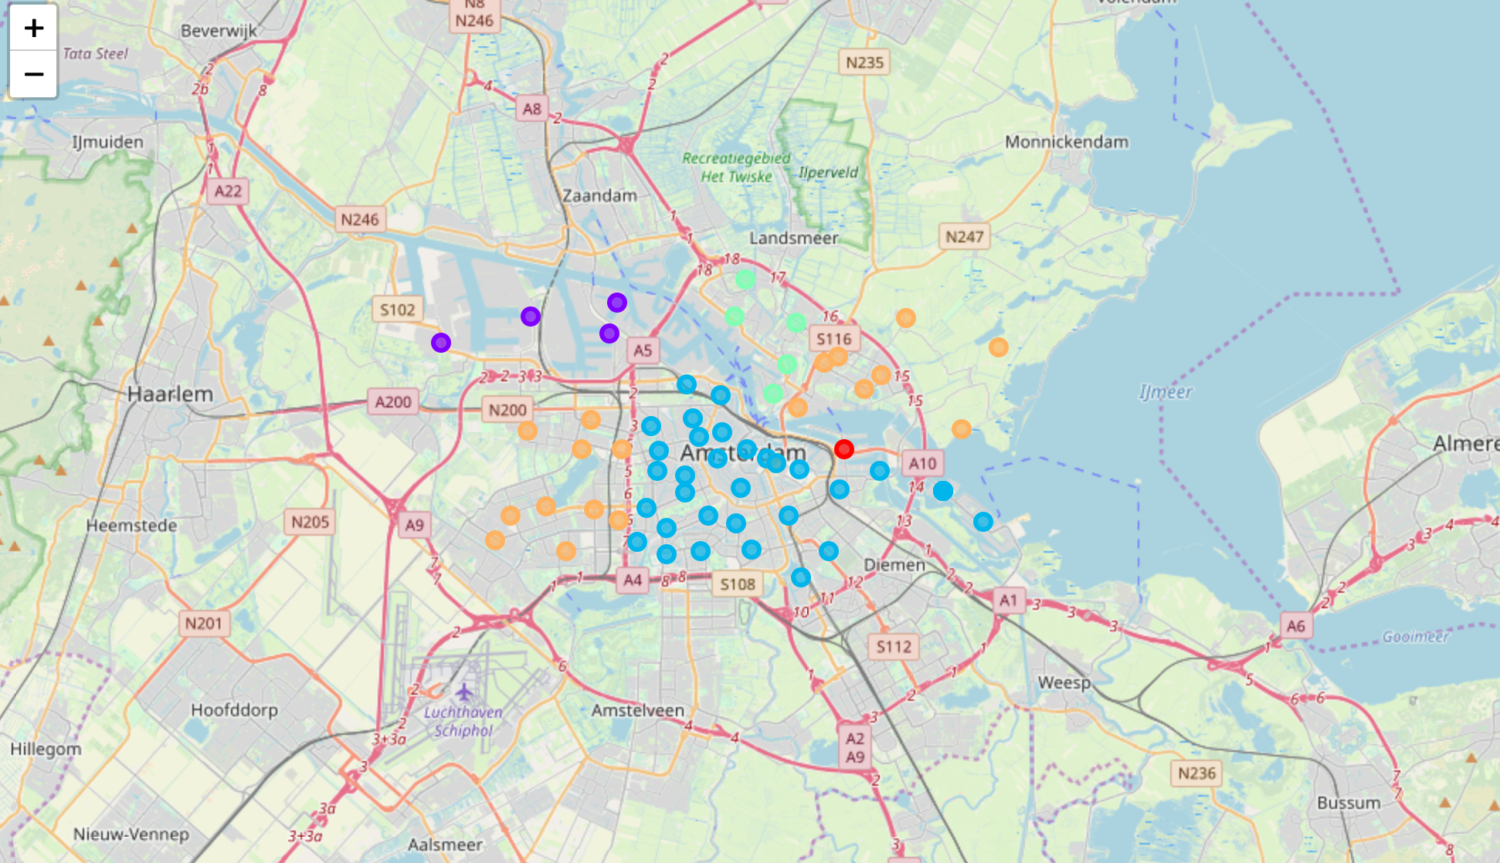
Results – Machine learning (cont.)

Slide 12
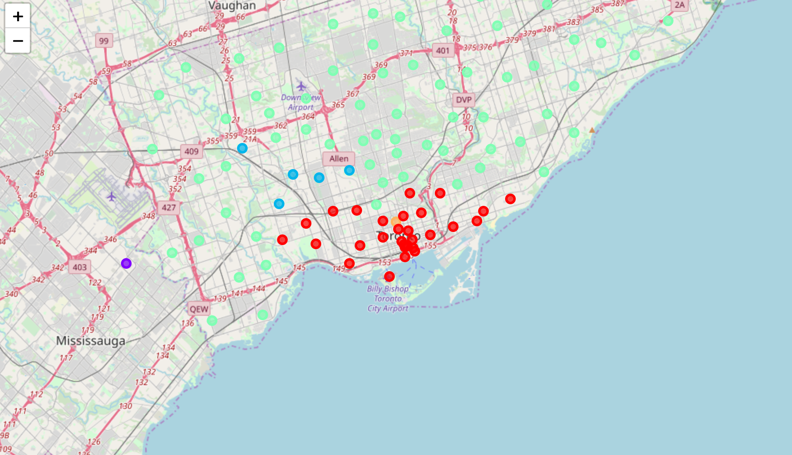
Results – Machine learning (cont.)

Slide 13
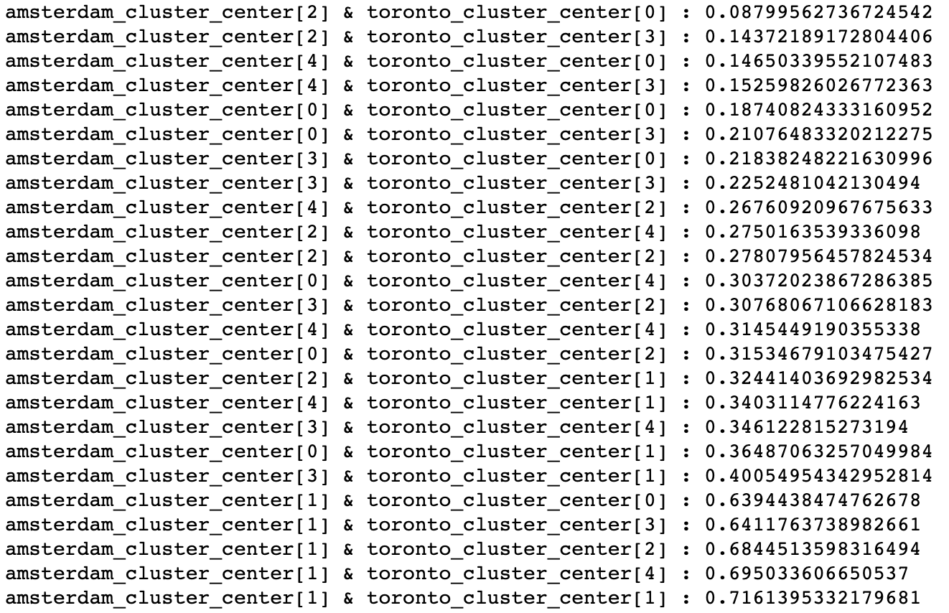
Results – Euclidean distances

Slide 14
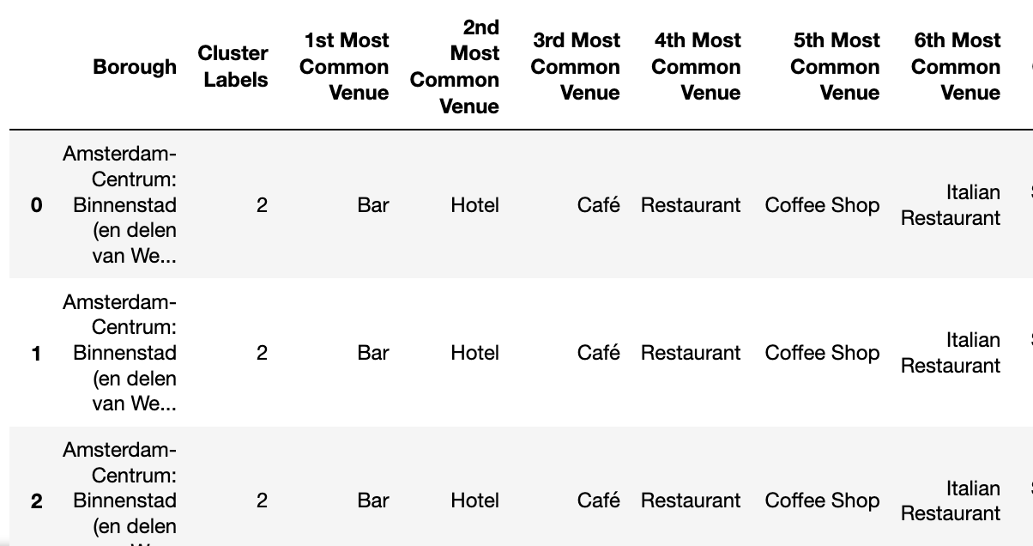
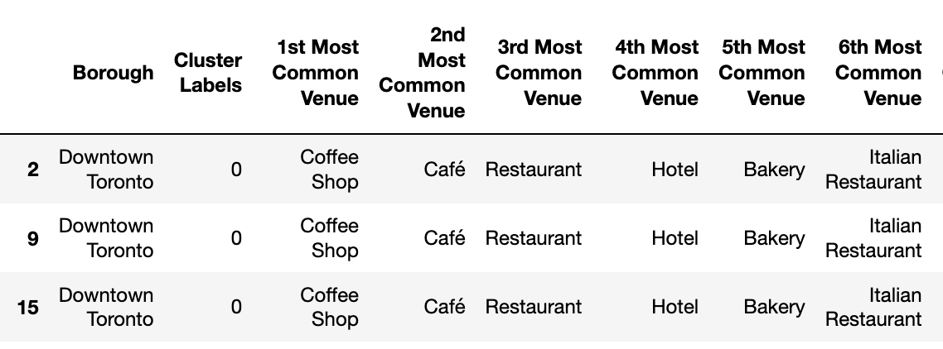
Similar clusters

Slide 15
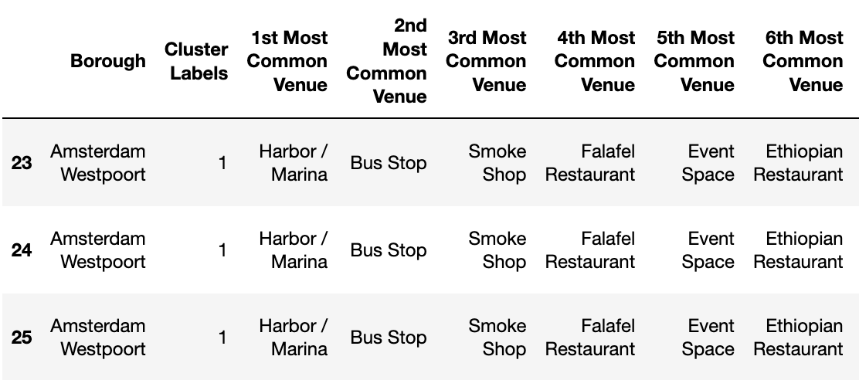
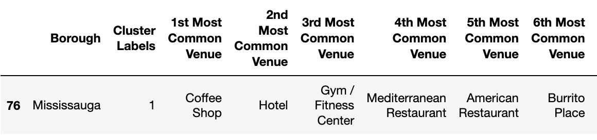
Dissimilar clusters

Slide 16
Discussion
The results show similar and dissimilar venue clusters of boroughs and neighborhoods in Amsterdam and Toronto and venues most commonly found in those clusters.
Knowledge about venue clusters in one city center can be used for decisions to be made about the other city center by organizations in the tourism industry, organizations considering investments in venues, and public decision makers.
Dissimilarities may point to unique aspects of Amsterdam and Toronto, presenting potential challenges and opportunities.

